Slide 1
voestalpine Railway Systems Romania
Performance on Track®

Slide 2
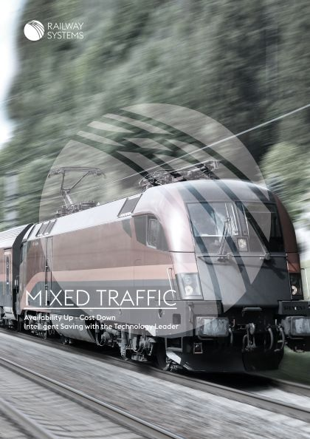
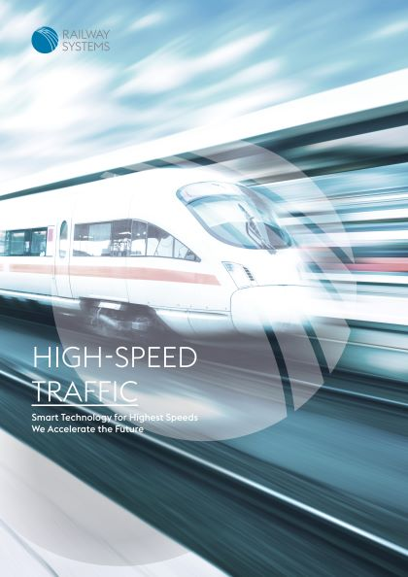
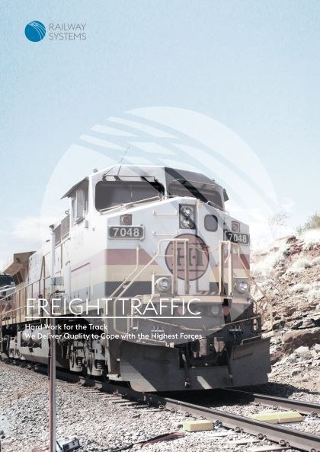
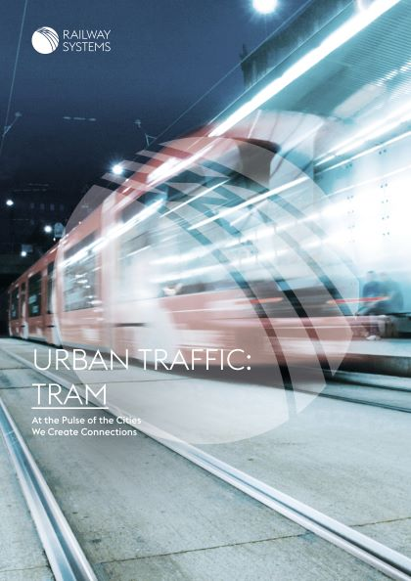

STRATEGIC BUSINESS AREAS
MIXED
Traffic
HIGH SPEED
Traffic
FREIGHT
Traffic*
URBAN Traffic**
Tram Metro
*Freight Traffic consists of the sub areas Industry and Heavy Haul.
**Urban Traffic consists of the sub areas Commuter, Metro and Tram.
voestalpine Railway Systems
voestalpine Railway Systems

Slide 3
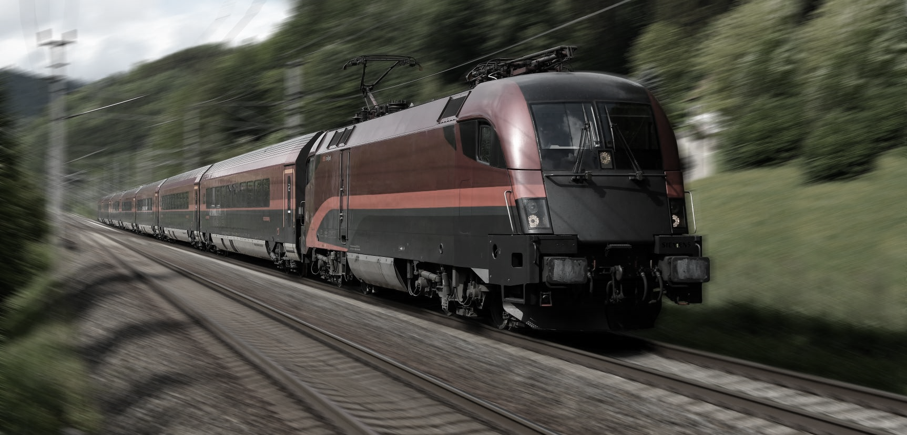
MIXED TRAFFIC
AVAILABILITY UP – COST DOWN
voestalpine Railway Systems
voestalpine Railway Systems

Slide 4
MIXED TRAFFIC
AVAILABILITY UP – COST DOWN
    Environment & Challenges
    Increasing train frequencies and axle loads
    Decreasing maintenance windows
    Increasing costs and rising performance pressure for railway organizations
    Our Solutions
    The largest portfolio of heat-treated premium and super premium rail grades
    Product recommendations based on LCC database
    System solutions with optimized overall availability and performance
    Pre-assembled JIT deliveries to minimize down times and maximize installed quality
    Comprehensive service portfolio to optimize track performance over the whole product lifecycle
voestalpine Railway Systems
voestalpine Railway Systems

Slide 5
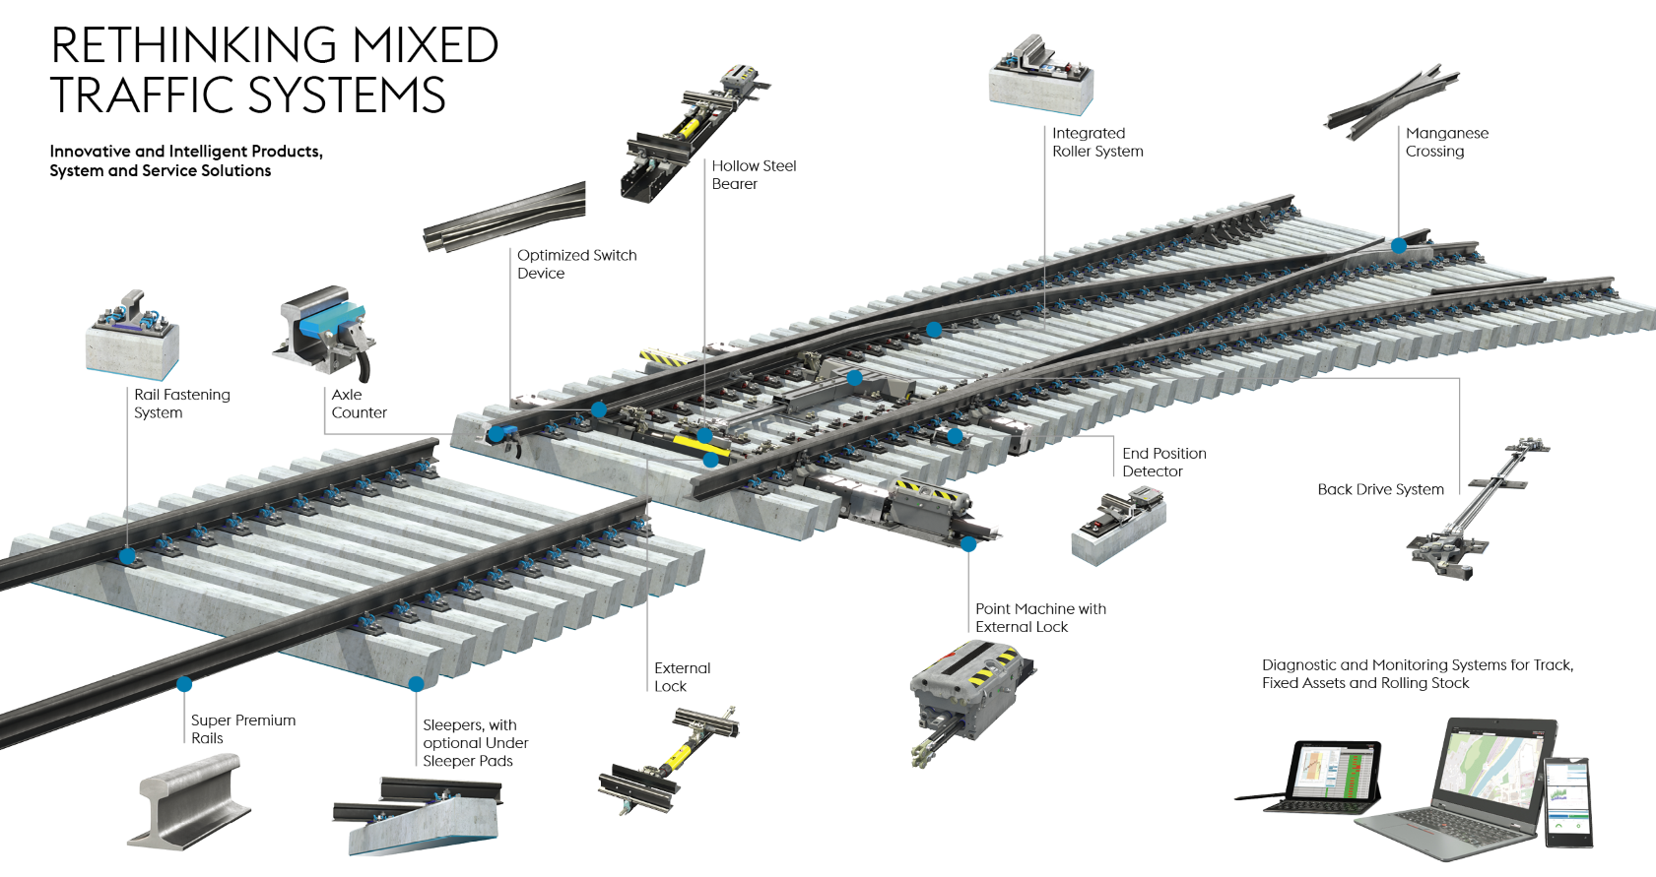
MIXED TRAFFIC
AVAILABILITY UP – COST DOWN
voestalpine Railway Systems
voestalpine Railway Systems

Slide 6
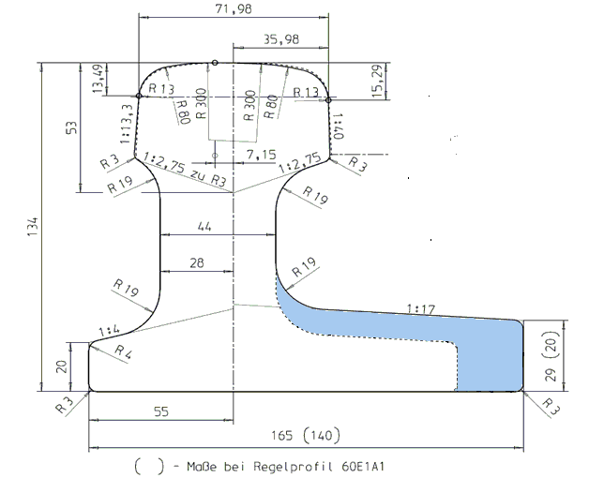
Self detection switch rail – profile 60E1A-84
The need:
In 2016, ÖBB proposed the development of a new switch rail profile that is much stiffer in lateral direction than a standard switch rail profile with the aim to detect an object of 12mm size between switch rail and stock rail without using an external end position detector.
The solution:
      New 60E1A-84 profile
        Eliminates the end position detectors (costs)
        Increase availability of the turnout (less components)
        Reduce maintenance effort (costs)
voestalpine Railway Systems
voestalpine Railway Systems

Slide 7
Self detection switch rail – profile 60E1A-84
Tests results:
      Compatible with the actual turnouts geometry
      12 mm objects are detected without End Point Detector for 300m, 500m, 760m and 1200m radiuses
      Minimal opening between switch rail and stock rail remains the same
      Switch force remains the same
Actual status:
    OBB ordered in 2020 60 T/Os with the new profile 60E1A-84 in 2020
voestalpine Railway Systems
voestalpine Railway Systems

Slide 8
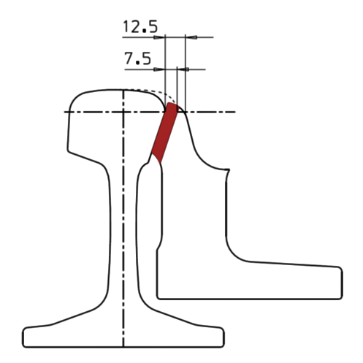
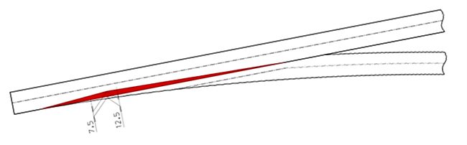
SWITCH DEVICE plus (TOZ plus):
The need:
The curved switch rails in turnouts with medium and small radii are exposed to high horizontal forces which will lead to an increased lateral wear of the switch blade. Breakouts lead to a restricted use period of the switch blade.
Benefits:
      The reinforcement along the switch rail is continuously increasing starting from the toe of the switch rail and is continuously decreasing after the most critical area of the switch rail
      Actual status:
      Installed in Austria (ÖBB) and Switzerland (SBB, BLS) since 2018
voestalpine Railway Systems
voestalpine Railway Systems

Slide 9
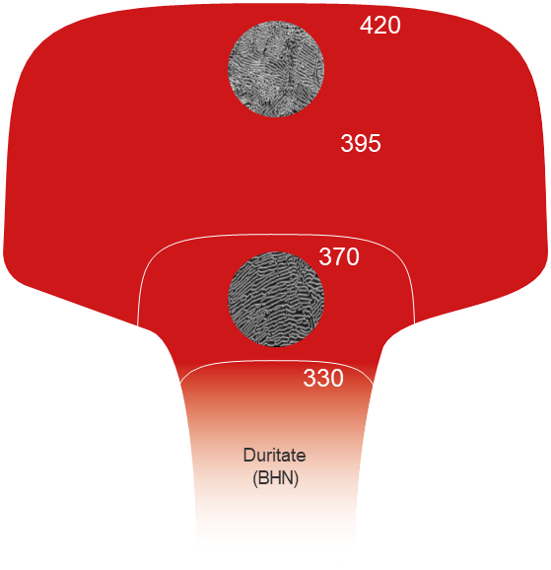
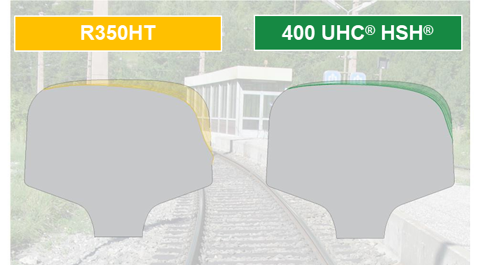
Rail Grade 400 UHC® HSH®
The need:
Wear, corrugation and head checking are usual defects of the rail surface
Benefits:
      High wear and rolling contact fatigue resistance
        Decrease of maintenance (costs)
        Significant longer life cycle (costs)
        Test results:
        Enlarging of rail service life by a factor of 2 compared to R350HT
      Actual status:
      Recommended by INNOTRACK for curves <300 m
      Installed in Austria (ÖBB) and Switzerland (SBB, BLS) since 2018
voestalpine Railway Systems
voestalpine Railway Systems

Slide 10





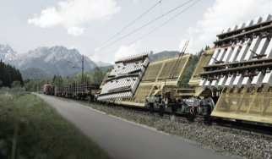
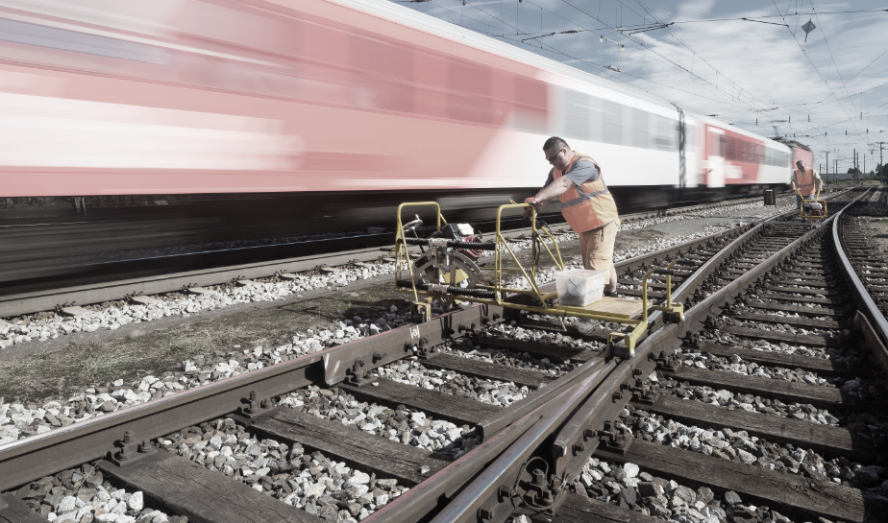


SERVICE EXPERTISE
TRACK SOLUTIONS
PREPARE
START
RUN
PERFORM
CONSULTING, ENGINEERING & TRAINING
SUPPLY, LOGISTICS &
INITIAL SERVICE
MAINTENANCE &
RECYCLING
TRACK MANAGEMENT
www.voestalpine.com/railway-systems
www.voestalpine.com/railway-systems
www.voestalpine.com/railway-systems
www.voestalpine.com/railway-systems
voestalpine Railway Systems
voestalpine Railway Systems

Slide 11

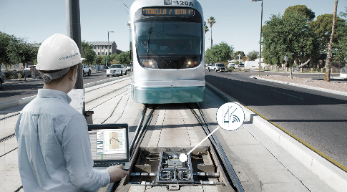
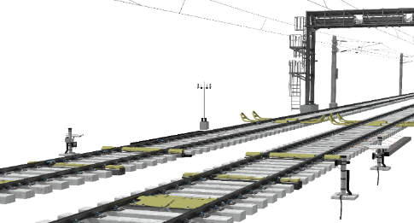
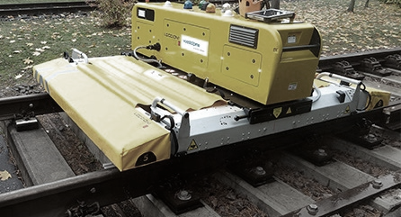
OUR VISION
THE DIGITAL RAILWAY
Innovative diagnostic portfolio
Intelligent infrastructure
Smart IT tools and apps
Virtual models & systems
voestalpine Railway Systems
voestalpine Railway Systems

Slide 12
THE DIGITAL RAILWAY – Check points
  Measurement & monitoring
  Automatic Vehicle Identification [AVI]
  Derailment Detection [DRD]
  Hot Box Detection [HBD]
  Hot Wheel Detection [HWD]
  Dragging Equipment Detection [DED]
  Wheel Defect Detection [WDD]
  Weighing in Motion [WIM]
  Environmental Condition Monitoring [ECM]
  Acoustic Monitoring Sensor [AMS]
  Profile Validation System [PVS]
voestalpine Railway Systems
voestalpine Railway Systems

Slide 13
Performance on Track®
voestalpine Railway Systems
voestalpine Railway Systems
24.03.2021
voestalpine Railway Systems

